Slide 1
Data 606 Capstone Project Australian Weather Prediction
Professor: Chaojie Wang
Appakondreddigari Likhith Kumar Reddy

Slide 2
Agenda
Introduction and Problem statement
Dataset source and description.
Data preparation, cleaning and outlier analysis.
Exploratory data analysis and insight generation
Feature selection and machine learning modelling.
Summary
Conclusion and References.

Slide 3
Introduction and Problem Statement:
We are attempting to implement a predictive model using machine learning algorithms on the Rain Dataset to predict whether it will rain in Australia tomorrow.
The Australian Commonwealth Bureau of Meteorology provided a year's worth of daily weather observations gathered from the Canberra airport in Australia, which were then processed to produce this sample dataset for demonstrating data mining using Python.

Slide 4
Data Source
Observations were drawn from numerous weather stations. The daily observations are available from
http://www.bom.gov.au/climate/data.
An example of the latest weather observations in Canberra: http://www.bom.gov.au/climate/dwo/IDCJDW2801.latest.shtml
Definitions adapted from http://www.bom.gov.au/climate/dwo/IDCJDW0000.shtml
Data source: http://www.bom.gov.au/climate/dwo/ and http://www.bom.gov.au/climate/data.
Copyright Commonwealth of Australia 2010, Bureau of Meteorology.
This dataset contains about 10 years of daily weather observations from numerous Australian weather stations, I has around 23 columns, 145460 rows.

Slide 5
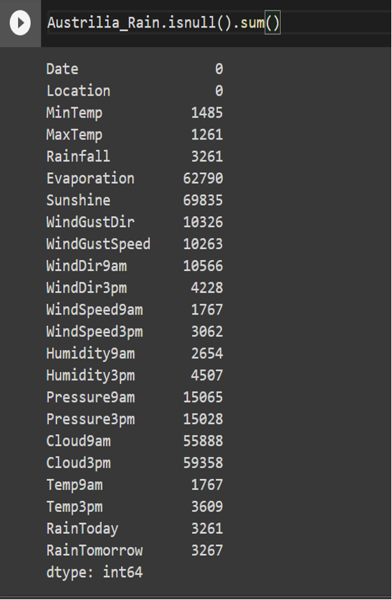
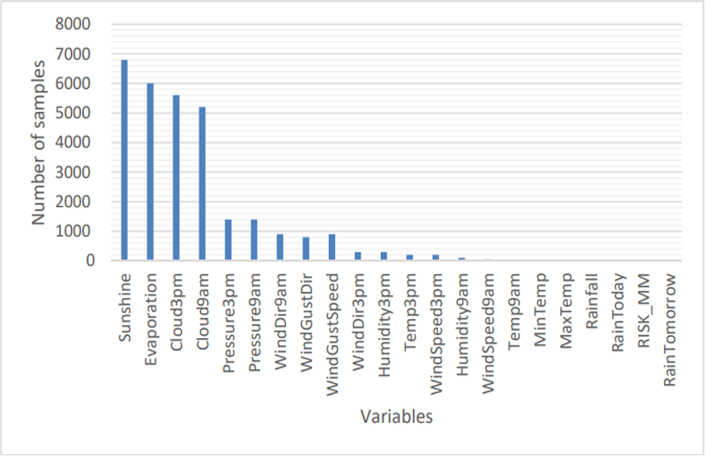
Data Preprocessing
Identifing Missing Data
Finding Null Values
Filling Null values
Finding Number of variables with value “NA”.

Slide 6
Result of Preprocessing
The following variables were eliminated:
• Date (eliminated because they are string variables)
• Rainfall (eliminated because they are highly related to the RainToday variable)
• RISK_MM (artificial variable obtained to predict the rain)
• The variables WindGustDir, WindDir9am, and WindDir3pm (each is split into two variables containing the cosines and sines of the wind direction angles).
The samples that had “NA” were replaced by their Mode.

Slide 7
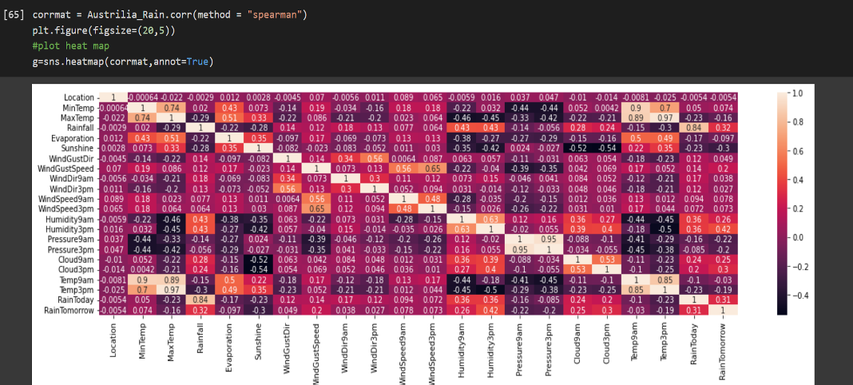
Data Visualization
In this heat map we are getting the correlation between our target variable "RainFall" and the other variables in the dataset.
Correlation can be seen with "MinTemp,windDir"

Slide 8
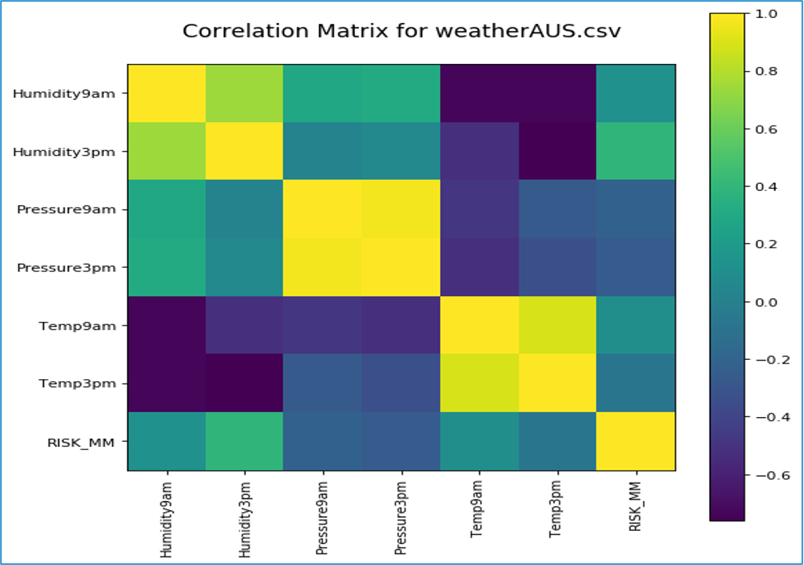
Correlation Matrix for continuous variables.
We plot a correlation matrix for the continuous variables in the dataset.
We see the same in the above heat maps.

Slide 9
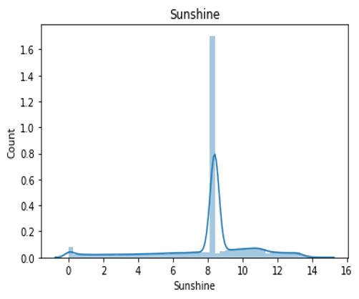
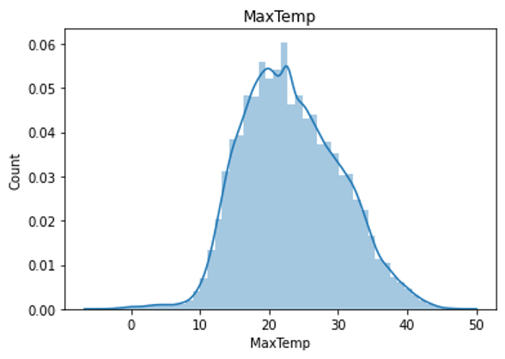
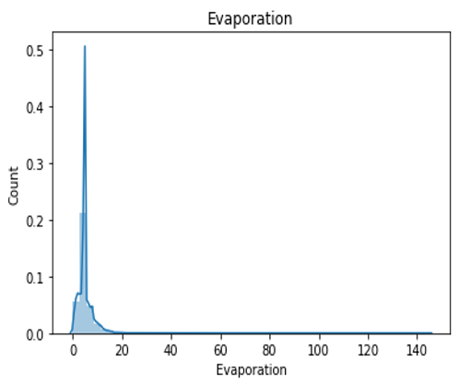
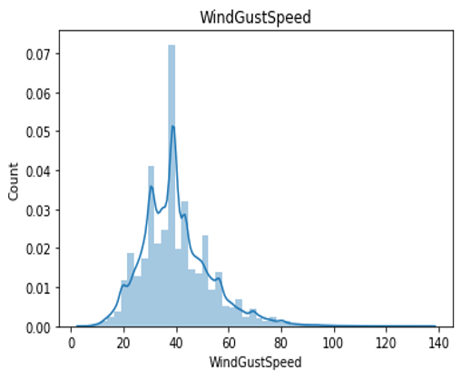
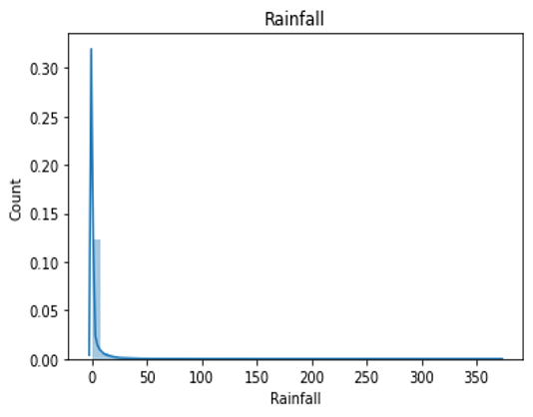
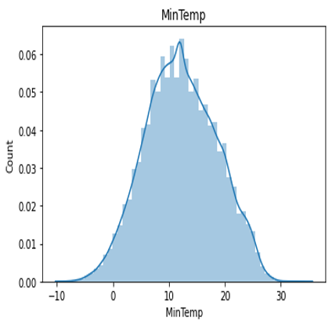

Slide 10
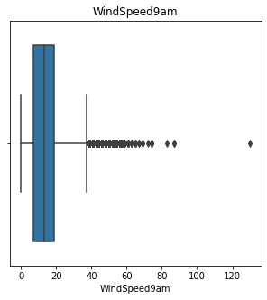
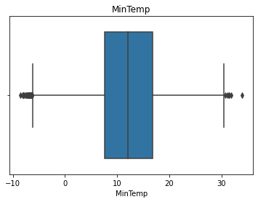
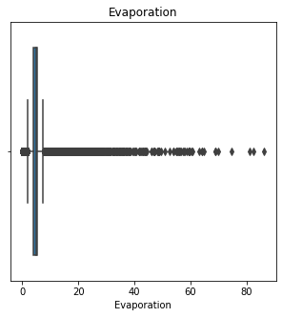
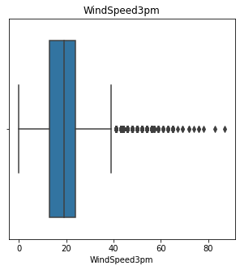
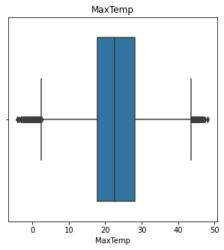
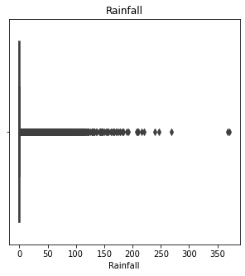
Plotting box plots to check for outliers

Slide 11
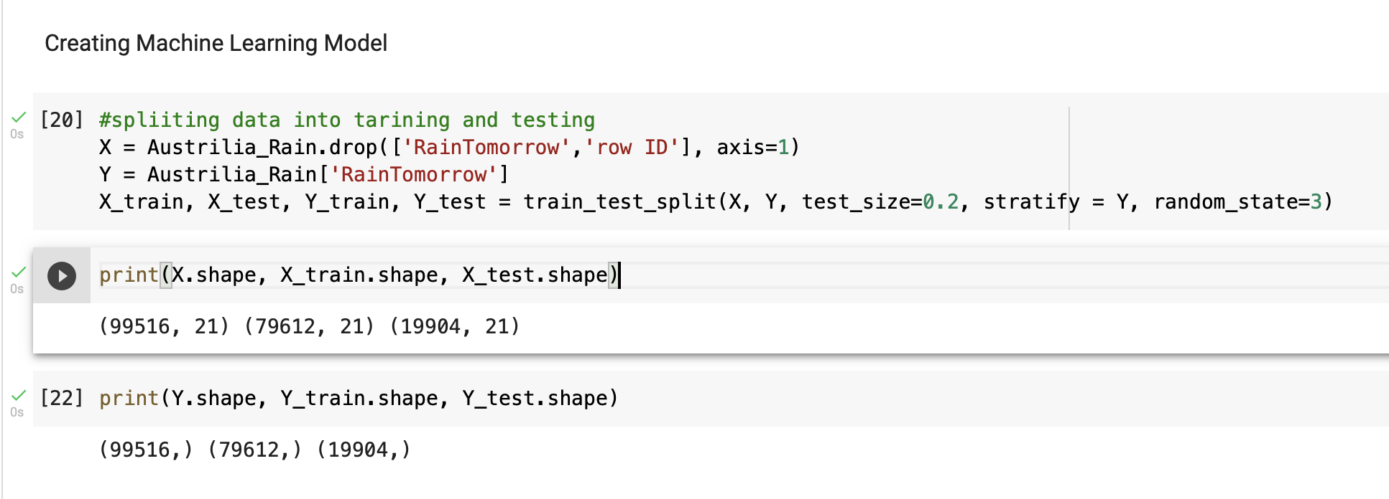
Creating Machine Learning Model:
Splitting data into Training and Testing data
Printing shape and size of data

Slide 12
Machine learning models used
Logistic Regression
KNeighbor classifier
Random Forest classifier

Slide 13
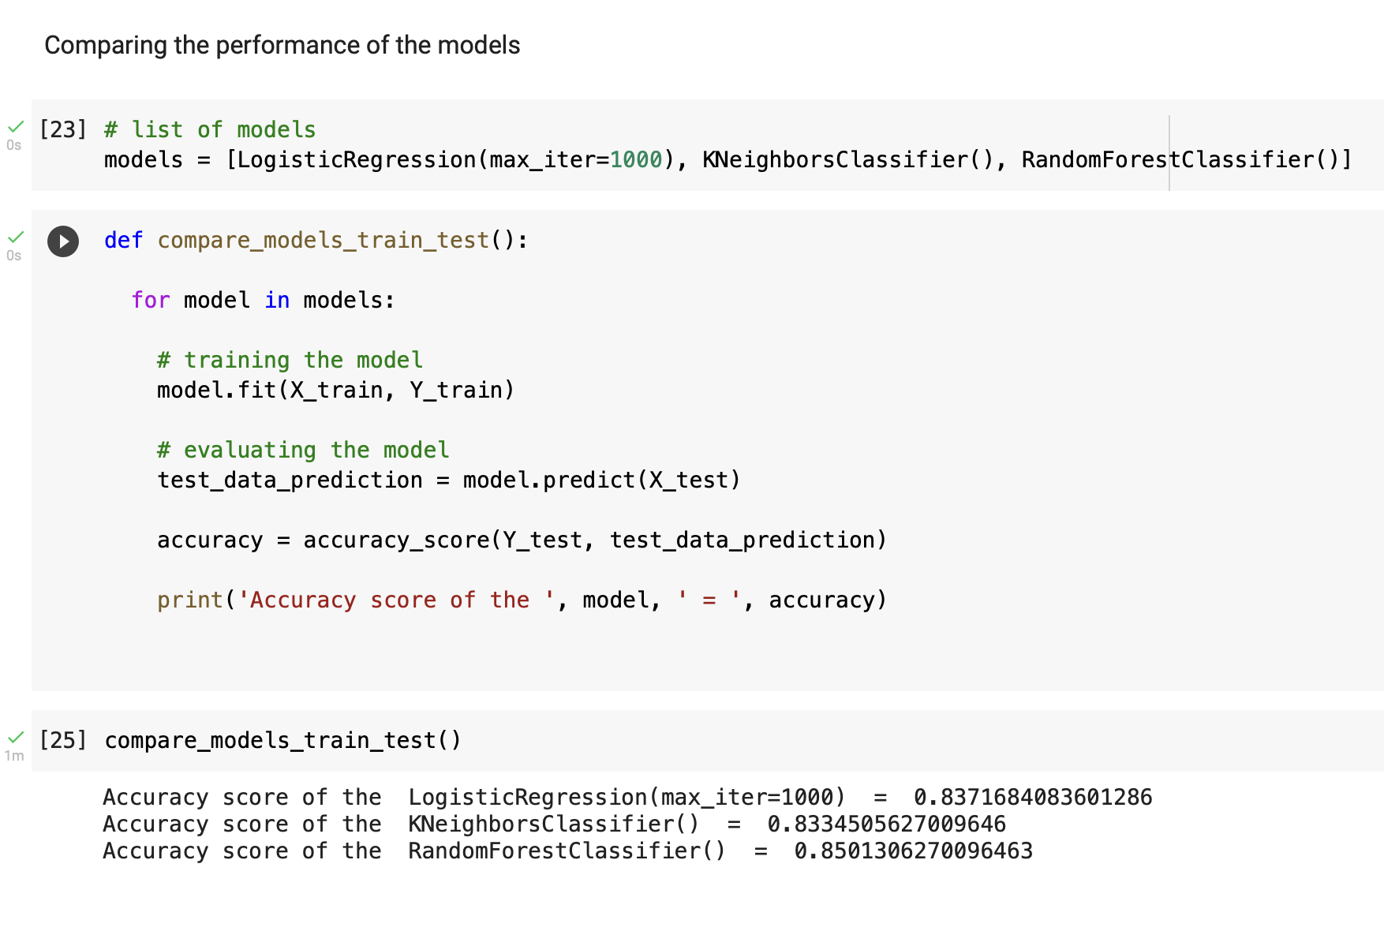
Comparing the performance of Models
The accuracy scores are as follows:
LogisticRegression is 0.837
KNeighborsClassifier is 0.833
RandomForestClassifier is 0.85

Slide 14
Cross-validation
Cross-validation is a technique for evaluating ML models by training several ML models on subsets of the available input data and evaluating them on the complementary subset of the data.
Properties of Cross Validation
Cross-validation is a very powerful tool. We can use our data more effectively and learn considerably more about the effectiveness of our algorithm thanks to it.
It might be simple to overlook something and apply the same data across multiple pipeline phases in sophisticated machine learning models.

Slide 15
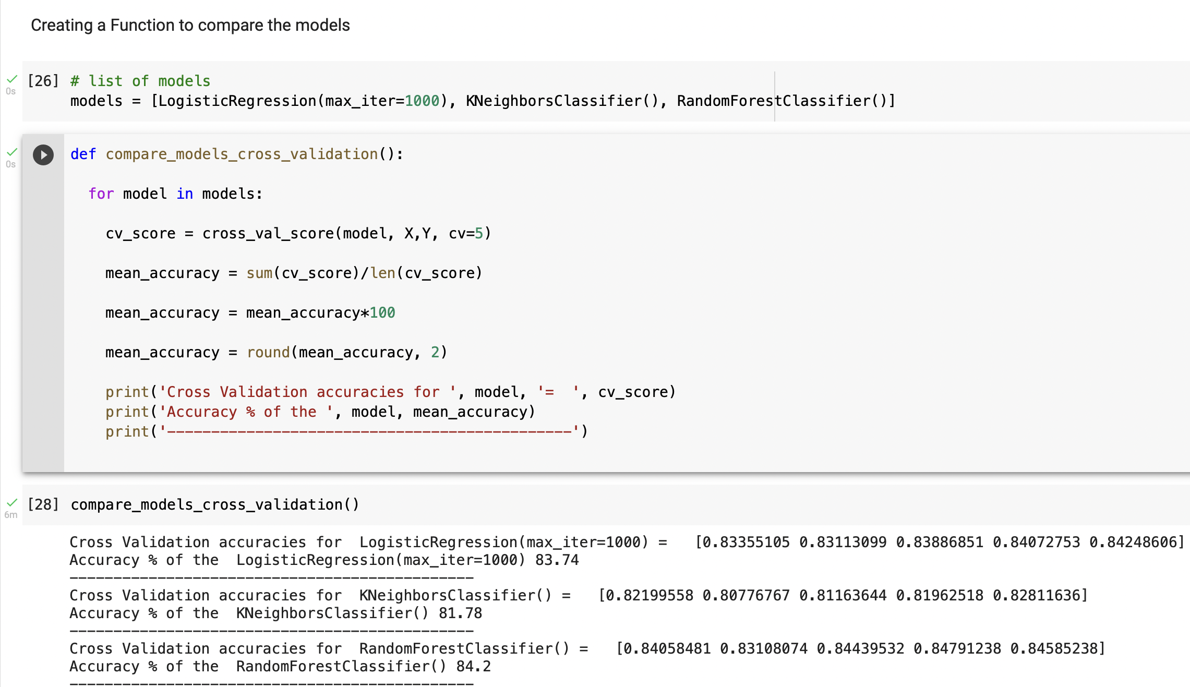
The MEAN accuracy scores after cross validation are as follows
Logistic Regression is 83.74
KNeighbors Classifier is 81.78
Random Forest Classifier is 84.2

Slide 16
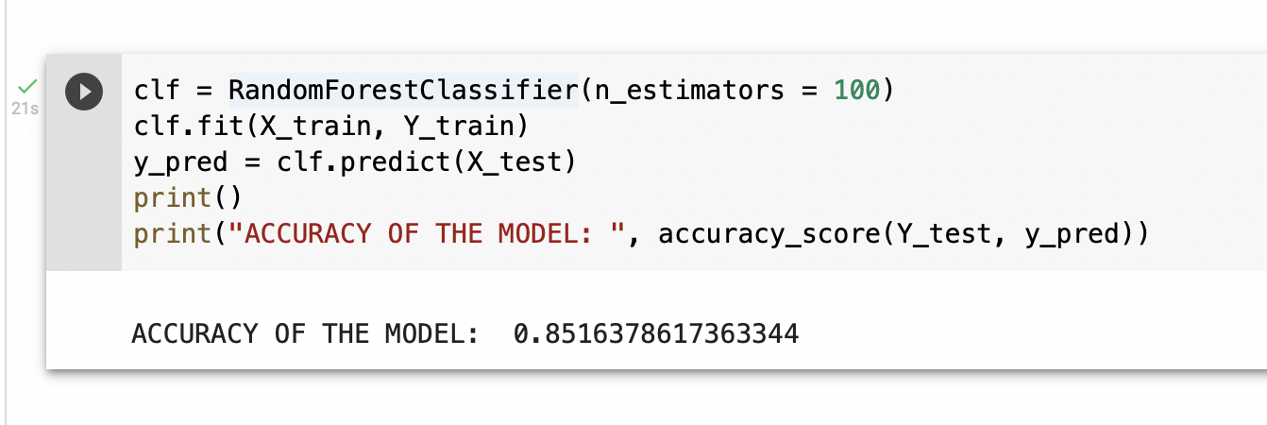
Selecting the model. Random Forest has the highest accuracy score hence we use this to classify points.

Slide 17
Summary
Extract data from the dataset and convert it into a pandas data frame. Print the shape and size of the converted dataframe.
Describe various features of the dataset using describe function.
Clean and transform the dataframe using various machine learning libraries like sklearn, numpy, pandas.
Plot various plots to understand the relationship between various features of the dataset.
After applying all the pre-processing steps in our dataset, we must create our machine learning column which then can be split into training and testing data.
Choose an appropriate machine learning model using K-fold cross-validation Algorithm (k-fold cross-validation is a procedure used to estimate the skill of the model on new data). Identify the potential features in our dataset.
The model that performs best in hyperparameter tunning will be chosen as our machine learning model.

Slide 18
Conclusion
The purpose of this study was to see if machine learning techniques could be used to solve the problem of rainfall forecasting in Australia. This method has previously been used in countries additional to Australia with a variety of monthly, annual, and other time period datasets. This study took place in Victoria and Sydney. Choosing an appropriate machine learning model using the K-fold cross-validation Algorithm and identifying the potential features in our dataset. Generating a model that performs best in hyperparameter tunning will be chosen as our machine learning model and can be used for further implementation.

Slide 19
References
[1]. V. Rao and J. Sachdev, "A machine learning approach to classify news articles based on location", 2017 International Conference on Intelligent Sustainable Systems (ICISS), pp. 863-867, 2017.
[2]. V. Kumar and S. Minz, "Poem classification using machine learning approach", Proceedings of the Second International Conference on Soft Computing for Problem Solving (SocProS 2012), pp. 675-682, December 28–30, 2012.
[3]. B.Pang, L. Lee and S. Vaithyanathan, "Thumbs up? Sentiment classification using machine learning techniques" in Language Processing (EMNLP), Philadelphia, pp. 79-86, July 2002.
[4]. B. Stehman, "Selecting and interpreting measures of thematic classification accuracy", Remote Sensing of Environment, 1997.

Slide 20
Thank You

